Slide 1
CVS Commercial Care Compass Software Release May 15, 2024
Steps to Take After A Software Release
Compass – Add Alternate ID(s) To Authentication Flow
Compass – Create/View Eligibility Support Task for No Member in Session
Compass – Prescription Hold Error Message
Compass – Paper Claim – myPBM Nursing Home
Compass – myPBM Override Member Mail In Delay
Compass – DPC Creation Screen (Related Fields)
Compass – ARR/ARP Disabled for Controlled Medication
Compass – Future Dated Accounts (Search by NPI)
Description: Outlines the new features for the May 2024 Software Release for CVS Commercial Care effective 05/16/2024. Please give us your feedback about this Announcement by completing this brief survey!

Slide 2
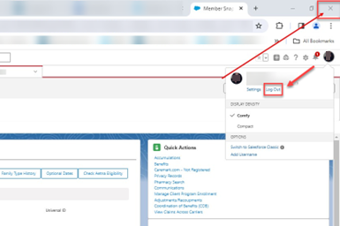
Steps to Take After a Software Release
Each time a software release is completed, you must clear your cache. Complete the following steps:
Step | Action
1 | Click on your profile picture next to the Bell icon on the top right of the Compass application and select Log Out. • Do not click the X to close the browser as this will not log you out of the Compass system. • If you forget to log out, refer to Clearing Your Cache (008655).
Top of Document

Slide 3
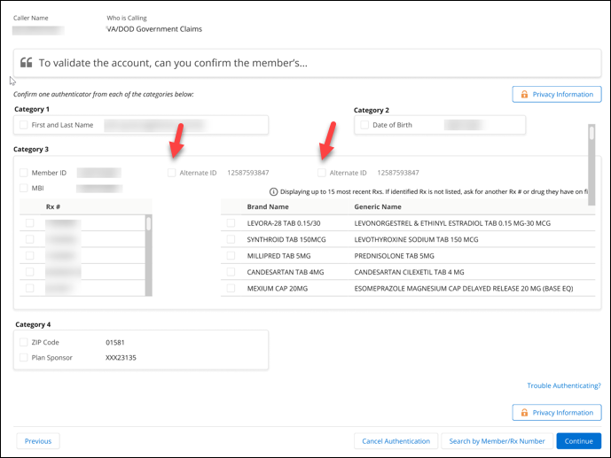
Compass – Add Alternate ID(s) to Authentication Flow
Summary of Impact
Screen Behavior Changes – Search by member-Search Results
Line of Business – All LOB’s
Current State – New authentication token do not display on the token screen
Future State – Two new fields named Alternate ID and Alternate ID 2 will be added to the authencation token screen. Alternative ID’s will each be considered an authentication token and will satisfy category 3 if selected. Alternative ID and Alternative ID 2 will be beside the current member ID Number and will each have their own corresponding checkbox. When the Alternative ID or Alternative ID 2 is not present, fields should remain (blank) and check box will display unavailable to select.
Top of Document

Slide 4
Compass – Create/View Eligibility Support Task for No Member in Session
Summary of Impact
Screen Behavior Changes – Search by Member-Search Results
Line of Business – All LOB’s
Current State – Users do not have the ability to create or view a support task without having a member in session
Future State – Users will have the option to submit or view a support task with no member in session.
Compass Users will have the ability to create or view a support task outside of a member account (No member in session scenarios).
Support Task Actions display: 1.) Create Eligibility Support Task 2.) View Eligibility Support Task.
If users select to create, the two options will display 1.) Member/Spouse/Dependent Not on file 2.) Ineligible Member/Spouse/Dependent/CVSID. Tool Tip will display for Create Eligibility Support Task “Only create a support task when a member record cannot be located in Compass after exhausting all search options, or if you get a CVSID error while in member record and are unable to create a support task while in that case.”
If users select to view eligibility support task for no member in session, they will be able to view the support task created for members that do not have active coverage. The view list will be the same as the “standard” support task list view we currently have.

Slide 5
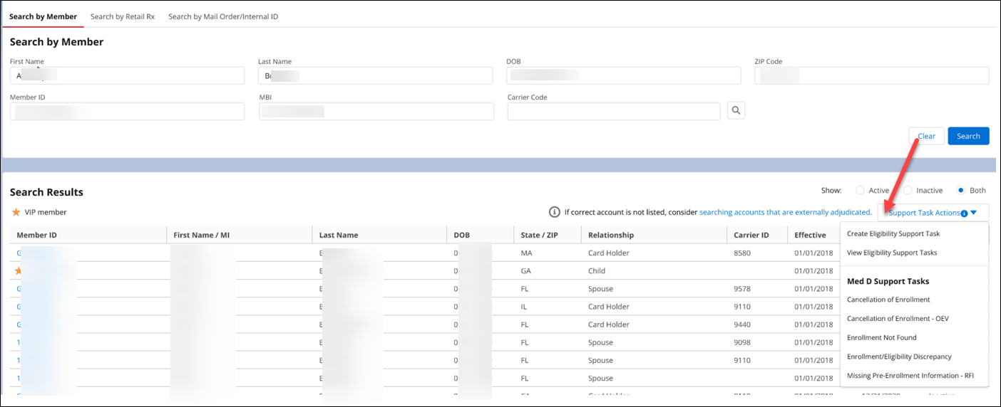
Compass Users will have the ability to create or view a support task outside of a member account (No member in session scenarios).
Support Task Actions will display 1.) Create Eligibility Support Task 2.) View Eligibility Support Task.
If users selects to create the two options will display 1.) Member/Spouse/Dependent Not on file 2.) Ineligible Member/Spouse/Dependent/CVSID. Tool Tip will display for Create Eligibility Support Task “Only create a support task when a member record cannot be located in Compass after exhausting all search options, or if you get a CVSID error while in member record and are unable to create a support task while in that case.”
If users selects to view eligibility support task for no member in session, they will be able to view the support task created for members that do not have active coverage. The view list will be the same as the “standard” support task list view we currently have.
Top of Document

Slide 6
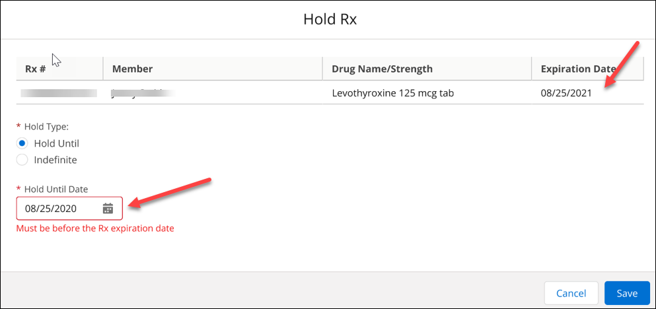
Compass - Prescription Hold Error Message
Summary of Impact
Screen Behavior Changes – Hold Rx
Line of Business – All LOBs
Current State – Compass isn’t validating the hold until date entered
Future State – When a user is entering a hold until date for a prescription, the system will validate the hold until date entered. The validation will make sure that the date entered is greater or equal than the expiration date of the prescription. Compass will show error message if it does not meet date range. Error message will display “Must be before the Rx Expiration date”.
To correct: Update the date range.
Top of Document

Slide 7
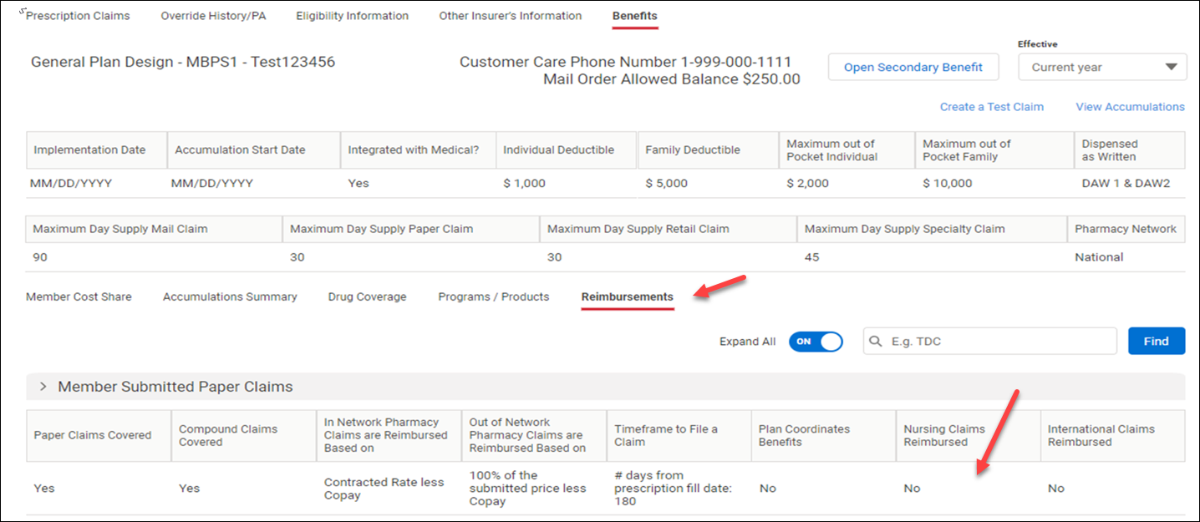
Compass - Paper Claim - myPBM Nursing Home
Summary of Impact
Screen Behavior Changes – Reimbursement sub-tab-Expand the Member Submitted Paper Claims section
Line of Business – All LOBs
Current State- Compass isn’t display the plans nursing home paper claim information on the reimbursement sub tab
Future State- New column will display between Plan Coordinates Benefits and International Claims Reimbursed. The new column will be labeled Nursing Home, which will provide users nursing home paper claim details.
Top of Document

Slide 8
Compass - myPBM Override Member Mail In Delay
Summary of Impact
Line of Business – All LOB’s
Screen Behavior Changes – Benefits Tab-Override tab within benefits – No Mockup
Current State – Member mail in delay override details aren’t available within the benefits tab
Future State – Compass is expanding the ability to view member mail in delay override details within the benefits tab. This new override will have its own section and rules for viewing just like other overrides allowed.
Top of Document

Slide 9
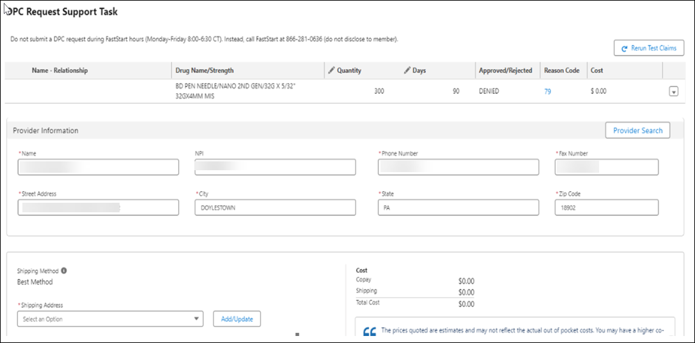
Compass - DPC Creation Screen (Related Fields)
Summary of Impact
Screen Behavior Changes – Doctor Phone Call (DPC) Support task creation Screen
Line of Business – All LOBs
Current State – When navigating to the DPC request from New Rx (Either that Physician Selection or Quantity entry) the system is not loading the members address, phone # or payment method
Future State – Compass will load the missing details when creating a DPC request for a member. It will keep from having to swivel off the screen to obtain the information needed to complete request.
Top of Document

Slide 10
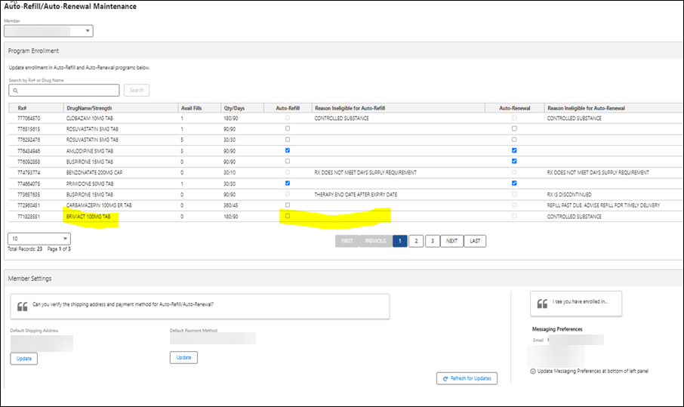
Compass - ARR/ARP Disabled for Controlled Medication
Summary of Impact
Screen Behavior Changes – Auto Refill/Auto Renewal Maintenance Screen
Line of Business – All LOBs
Current State – Currently the ARR/ARP isn’t disabled for controlled medication
Future State – Compass will disable the ARR/ARP program for controlled medication. This will assist users to not enroll member’s prescriptions incorrectly.
Top of Document

Slide 11
Compass - Future Dated Accounts (Search by NPI)
Summary of Impact
Screen Behavior Changes – Change Pharmacy tab-attempt to locate a pharmacy using NPI#-No Mockup
Line of Business – All LOBs
Current State – When attempting to search pharmacy using an NPI# you get a message stating there are no in network pharmacies found for future dated member accounts( inactive date in the future)
Future State – Compass observation fix. When attempting to locate a pharmacy using the NPI#, you will see results for future dated member accounts (inactive date in the future)
Top of Document

Slide 12
Not to Be Reproduced or Disclosed to Others without Prior Written Approval
ELECTRONIC DATA = OFFICIAL VERSION / PAPER COPY = INFORMATIONAL ONLY
Top of Document

